Slide 1
Induction Proof and Loop Invariants

Slide 2
Mathematical Induction
First Principle
Second Principle

Slide 3
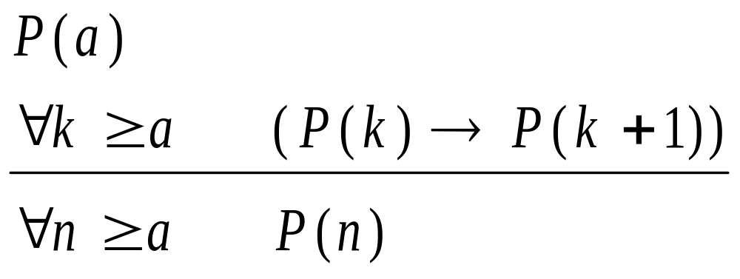
The First Principle of Mathematical Induction
Induction hypothesis
Induction basis
Induction step

Slide 4
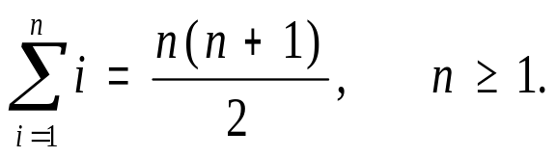
Example
Show that
  ? What is P(n)? What is a?
  Induction Basis
  Induction Step
    Induction hypothesis

Slide 5
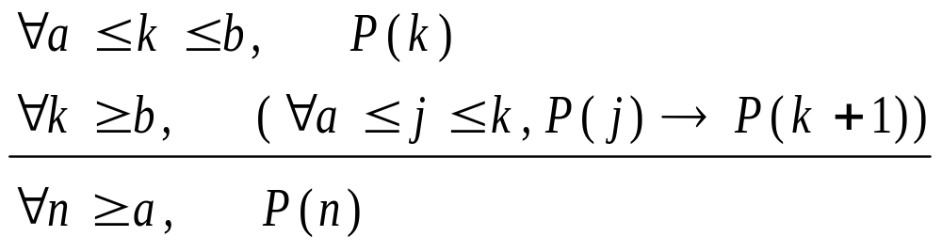
The Second Principle of Mathematical Induction
Induction hypothesis
Induction basis
Induction step

Slide 6
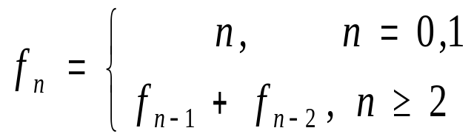
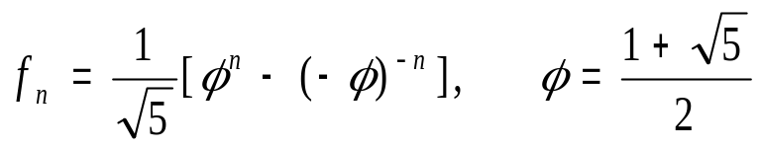
Example
Define
Show that
  ? What is P(n)? What are a and b?
  Induction Basis
  Induction Step
    Induction hypothesis

Slide 7
Example
double fibRecursive(int n)
{
double ret;
if (n<2)
ret = (double)n;
else
ret = fibRecursive(n-1) +
fibRecursive(n-2);
return ret;
}
How many additions in terms
of n?
Assume the total additions is g(n).
g(n) = 0, n =0, 1
g(n) = g(n-1) +g(n-2)+1, n ≥2

Slide 8

f_{n} versus g(n)
n | 0 | 1 | 2 | 3 | 4 | 5 | 6 | 7 | 8
f_{n} | 0 | 1 | 1 | 2 | 3 | 5 | 8 | 13 | 21
g(n) | 0 | 0 | 1 | 2 | 4 | 7 | 12 | 20 | 33
2 f_{n} | 0 | 2 | 2 | 4 | 6 | 10 | 16 | 26 | 42
Prove by induction that

Slide 9
Loop Invariants
To prove some statement S about a loop is correct. Define S in terms of a series of smaller statements, S₀, S₁, …, S_{k}, where
  The initial claim, S₀, is true before loop begins
    Initialization (compared to induction basis)
  If S_{i-1} is true before iteration i begins, then S_{i} will be true after iteration i is over
    Maintenance (compared to induction step)
  The final statement implies S
    Termination (conclusion. This step is different from a typical induction proof)

Slide 10
Example: minArray
// return the value of the minimum
// element of array a
// n ≥ 1
int minArray(int a[n])
{ int m = a[0];
for (i=1; i<n; i++)
if (a[i] < m)
m = a[i];
return m;
}
Show that the algorithm
returns min(a[0..n-1]).
What is S_{i}?
S_{i}: m = min(a[0..i])

Slide 11
Prove Fn = fn
double fibIterative(int n)
{
double Fn_1, Fn_2, Fn;
int i;
if (n<2)
return ((double)n);
Fn_2 = 0;
Fn_1 = 1;
Fn = 1;
for (i=2; i<=n ; i++) {
Fn = Fn_1 + Fn_2;
Fn_2 = Fn_1;
Fn_1 = Fn;
}
return Fn;
}
S_{i}: Fn_1=f_{i}; Fn_2=f_{i-1}; Fn=f_{i}, i=1,2,….,n
Initialization: Prove initial claim S₁
Maintenance: Prove: Si-1 Si
Termination: S = Sn

Slide 12
Insertion sort
void insertionSort(int A[0..n-1], int n)
{
int i, j, tmp;
for (i=1; i<n; i++) {
tmp = A[i];
j = i-1;
while (j>=0 && tmp<A[j]) {
A[j+1] = A[j];
j--;
}
A[j+1] = key;
}
}
S_{i}: A[0..i] is a permutation
of the original sub-array
and sorted

